Slide 1
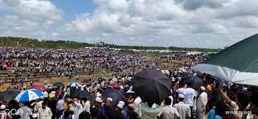
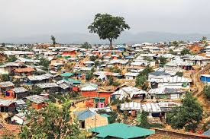
Presentation on PhD Thesis
Epidemiology and Socio-Demographic factors associated with different diseases and impact of Health Education in improving Health Behavior, Lifestyle and
Health Status of different FDMN Community in Rohingya Refugee Settlement, Cox’s Bazar, Bangladesh
Md Jahedul Islam
Department of Pathology and Parasitology
Chattogram Veterinary and Animal Sciences University (CVASU)
26th December, 2023

Slide 2
Panel of the Supervisors: Supervisor: Prof. Dr. Mohammad Alamgir Hossain Co-Supervisors: 1. Prof. Dr. AMAM Zonaed Siddiki 2. Prof. Dr. Sharmin Chowdhury Dept. of Pathology and Parasitology Chattogram Veterinary and Animal Sciences University (CVASU) Khulshi, Chattogram-4225, Bangladesh
CVASU

Slide 3
01
Background
02
Research problem
03
Aim of the study
04
Methodology
Outlines
05
Findings / Results
Discussion
06
07
Conclusion
08
Recommendation

Slide 4
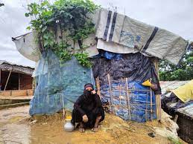
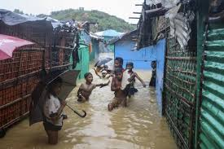
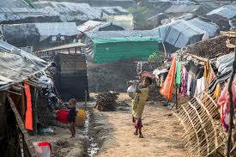
Background

Slide 5
Background
Globally, 89.3 million people live outside their country.
They are mostly migrants, people who leave their homelands in search of better opportunities.
However, over one-third are refugees, escaping political violence and other threats in their own country.
Currently the Rohingya refugee issue has become a big humanitarian crisis in Bangladesh.
This community has been compelled to leave their home place due to violence.
Most Rohingya migrants in Bangladesh are Forcibly Displaced Myanmar Nationals (FDMN).
The Rohingya have suffered decades of ethnic and religious persecution in Myanmar.

Slide 6
Background
Hundreds of thousands have fled to Malaysia, Indonesia, the Philippines and other countries.
Since March 2023, 1216733 Rohingya have migrated to Bangladesh, according to UNHCR.
The FDMN community has been densely sheltered in Cox’s Bazar as refugees in many camps.
The community is facing many health difficulties due to poor living conditions, limited resources, sanitation issues etc.
In many places, Rohingya camps are mostly overcrowded, with few supplies and major management issues.
Because of the crowded living conditions they pose a significant threat to the health of the general population.
They are also exposed to traumatic events related to war, destruction of property, loss of family members etc.

Slide 9
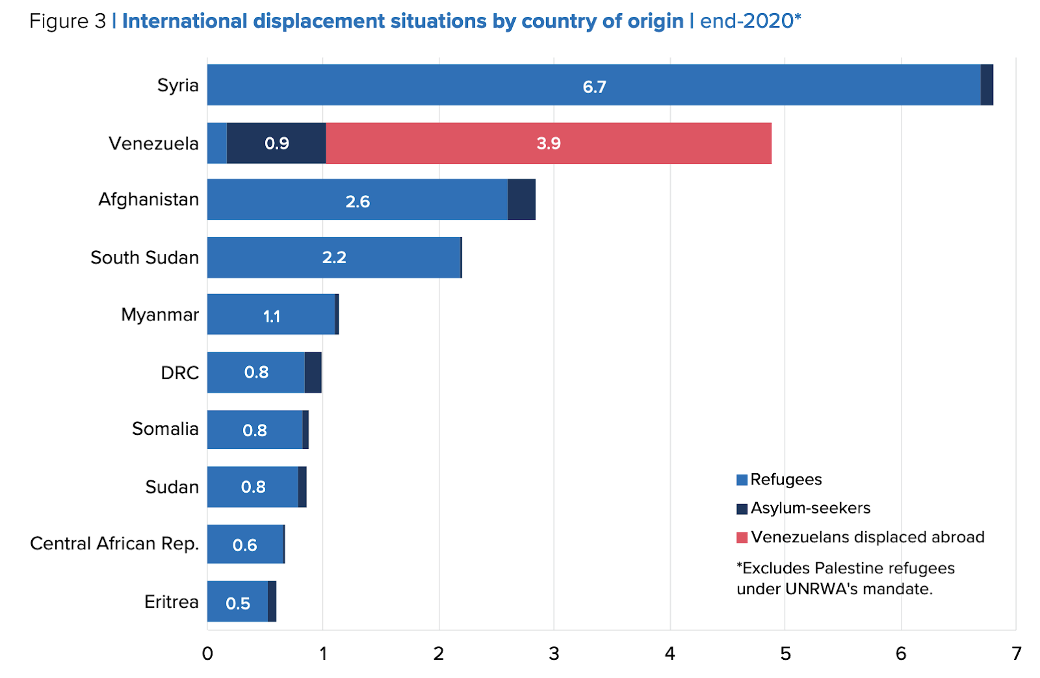
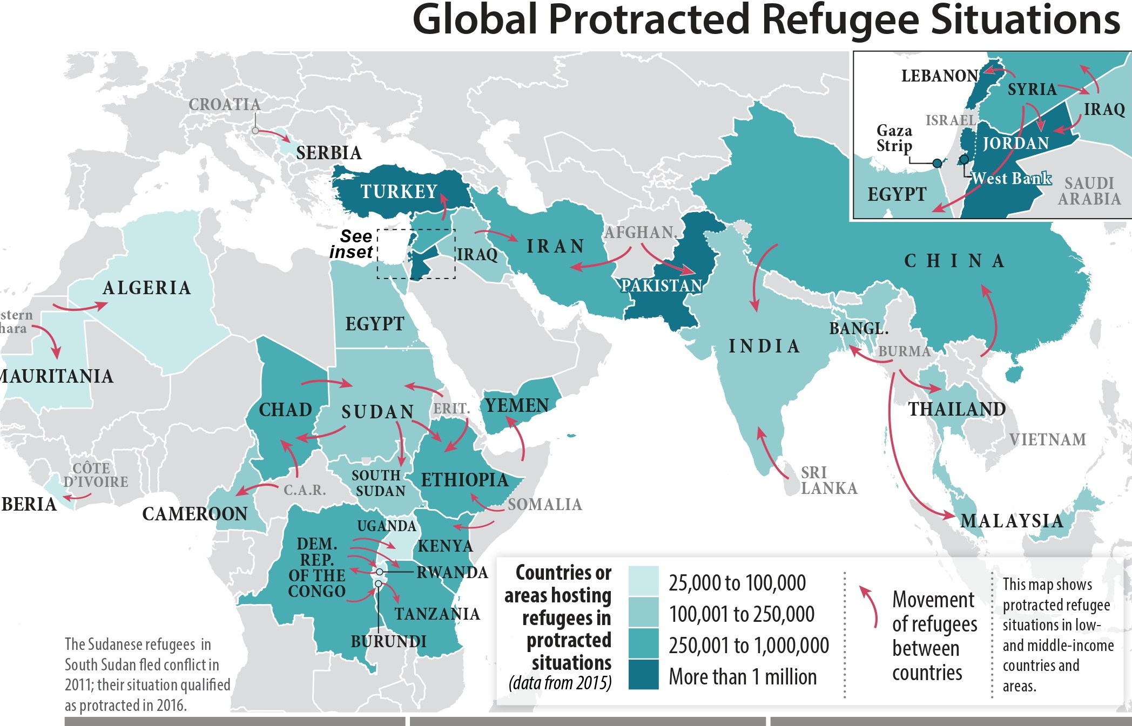
Global Refugee Situation
Global Refugee Situation
Conflicts, human rights abuses, and environmental reasons have caused an unprecedented number of refugees, around 89.3 million by 2022.
Global cooperation is needed to address core problems and provide effective solutions for refugees, including overcrowded camps, inadequate access to basics, and strains on host countries.
Conflicts, human rights abuses, and environmental reasons have caused an unprecedented number of refugees, around 89.3 million by 2021.
International cooperation is needed to address core problems and provide effective solutions for refugees globally, including overcrowded camps, inadequate access to basics, and strains on host countries.
Millions

Slide 10
Background Cont.....
Rohingya Refugee Situation
Bangladesh is home for over 1 million Rohingya people who have faced genocide, ethnic cleansing, and discrimination in Rakhine, Myanmar to date.
Children make up 52% of the population, and their health issues are significant.
Rohingya children have high rates of infectious diseases due to poor vaccination, undernutrition, overcrowding, filthy circumstances, and lack of safe water.
A measles-rubella vaccine was assessed to be necessary for 237,500 children aged 6 months to 15 years where other different communicable dieases are still prone, e.g., Scabies, RTI, Diarrhea etc.

Slide 11
Background Cont.....
Disease
Prevalence (%)
Health risks of Rohingya children in Bangladesh (study source: UNHCR, 2021)

Slide 12
Background Cont.....
Disease frequency among the Rohingya in the Kutupalong camp (study source: UNHCR, 2021)

Slide 13
Research Problem and Justification

Slide 14
Research Problem and Justification
Unregistered camps are overcrowded, poorly administered and deficient in supplies, worsening refugee circumstances.
Water, sanitation, and hygiene (WASH) facilities are scarce .
Unreliable and filthy water, especially from shallow tube-wells, causes health problems, causing waterborne infections.
Camp latrines propagate diseases. Poorly maintained or missing bathroom facilities make open defecation dangerous, especially for women and children.
Lack of solid waste collection facilities causes unrestricted dumping, harming water sources and public health.

Slide 15
Research Problem and Justification
High malnutrition rates make people more prone to deadly diseases.
Lack of medical care, combined by cost barriers to diagnosis and treatment, causes fitness loss, organ damage, and occasionally death.
Rohingya diseases limit production and increase burden for the society.
Diseased people become dependant, impeding communal development and national prosperity.
Social impact includes the ill community's incapacity to actively contribute to host country growth, increasing dependency.

Slide 16
Research Problem and Justification
Diagnosis and treatment costs put patient families in financial trouble.
The death of an earning member can plunge the family into hardship, requiring loans.
The government must spend money on refugee health and well-being.
Though a huge number of local and global NGOs provide different services beside Bangladesh Govt.’s cordial and responsible efforts in Health Education, BCC, Food and water Supply, Medical Camp and Medicine Supports, still different C&NCD are upstanding among Rohingyas.

Slide 17
General Objective
To study the -
epidemiology and socio-demographic factors associated with different diseases
the impact of health education in improving health behavior, lifestyle and health status

Slide 18
Specific Objectives
a) To determine the knowledge, attitude and practices regarding different diseases among the respondents.
b) To estimate the disease burden/occurrence among the community people.
c) To find out the impact of health education about different health issues including their health behavior, life style and health status of the respondents.
d) To reveal the socio-demographic factors associated with different diseases (both communicable and non-communicable) of the respondents.

Slide 19
Methodology

Slide 20
Methodology
Study Design:
A cross-sectional survey-based study
Study Population, Area & Duration:
Rohingya Refugee people of different ages (excluding children <18 years) and both genders
Rohingya Refugee settlement (3 Camps)
March 2020 - June 2023

Slide 21
Questionnaire
Socio-DemographicInformation
Sl. No. | Questions | Options
ID No
1 | Age in years | 18-20 Years 21-30 Years 31-40 Years 41-50 Years 51-60 Years
2 | Gender | Male Female
3 | Educational Status | Illiterate Primary SSC HSC Graduate
4 | Current Occupation (If any) | Doing nothing Small Shopkeeper Student Daily labor Street Hawker Imam Housewife Mazhee
5 | Types of Family | Nuclear Joint
6 | Monthly family income in BDT | <10K 10K >10K
Data collection tool: (Questionnaire)
A total of 8 questionnaires were first developed, then validated, then translated, and last personalized.
For linguistic validation, the questionnaire was translated into English and Rohingya language using forwarding and backward translation respectively.
Two times data collection with 6 months interval performed for chapter 3 study to determine the impact of health education.

Slide 22
Methodology
Explanatory Variables:
socio-demography
knowledge, awareness, attitude and practices
Knowledge on health status and health behaviors
disease burden and occurrence of different diseases-based variables
Inclusion criteria:
People with given consent and willingly joined. Both males and females of different age groups
Exclusion criteria:
< 18 years people and people who were unwilling and not able to provide information

Slide 23
Methodology
Sampling method:
Non-probability and purposive sampling methods have been followed
Data Collection Technique:
By following face-to-face interviews
Catagory of response in selected question types - 3 options - Yes/No/Not sure
Data Management Plan: (Statistical analysis)
Data was primarily entered into Microsoft Excel spreadsheet (version-2020)
Test of significance - Chi-square tests
The Statistical Package for the Social Sciences (SPSS) (version 20)
P<0.05 was considered as statistically significant
Notes:
only key words will be applied in each slides.

Slide 24
Methodology
Quality Control & Quality Assurance:
Regular supervision and guidance from the supervisor were taken
Data was checked and rechecked for reliability
Questionnaires were explained in local languages for better understanding
Interviewer were trained properly before collecting data

Slide 25
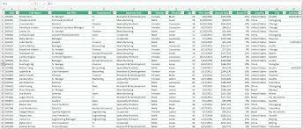
Study Flowchart
Thesis topic design by respected supervisors
Review of Literature on Title of Interest
Selection and designing physical map of places for data collection
Data were collected from the respondents using Questionnaire
Compilation of all data together in the record books and entry to the spreadsheets
Processing of the data using SPSS for analysis
Presentation of Data by charts / graphs and tables
Conversations with the supervisors regarding the findings of the research work and report writing
Draft Report Submission (considering corrections)
Finally, Thesis/Report Submission

Slide 26
Results

Slide 27
Conceptualization of our sequential progress
1
Knowledge, Attitude And Practices Regarding Different Diseases Among Different People Of FDMN Community In Rohingya Refugee Settlement, Cox’s Bazar, Bangladesh.
Findings offer significant insights into the understanding and behaviors
pertaining to both communicable and non-communicable
diseases within the Rohingyas
2
Impact of health education on regular health behaviour in improving health outcomes among the FDMN community in Cox’s Bazar, Bangladesh.
Study has revealed noteworthy correlations between socio-demographic
variables, knowledge pertaining to health education, and
individuals' attitudes towards health education.
3
Knowledge and Awareness on Occurrence of Different Diseases Among the Rohingya Refugee People: A Cross-Sectional Study on in Cox’s Bazar, Bangladesh.
Study's findings offer significant insights into the knowledge and awareness on different diseases, health behaviors, ideas on nutrients,
their sources, malnutrition and associated diseases.
4
Different socio-demographic factors associated with different diseases among different people of FDMN community in Cox’s Bazar, Bangladesh.
Paper provides a comprehensive analysis of the Socio-Demographic
factors influencing the prevalence of communicable and non-
communicable diseases within the Rohingya population.

Slide 28
Chapter # 01
Results
Objective: To determine the knowledge, attitude and practices regarding different diseases (both communicable & and non-communicable) among the respondents.

Slide 29
Figure 2: Distribution of the Respondents in Different Age Groups. n=3060
Results (Socio-Demographic Information)
Figure 1: Male-Female percentage among the Respondents.
n=3060

Slide 30
Results
Table 1: Distribution of the Respondents by Academic Backgrounds.
Educational Status | Options | Frequency | Percentage
 | Illiterate | 1931 | 63%
 | Primary Level | 958 | 33%
 | Secondary Level | 97 | 2%
 | Higher Secondary | 57 | 1%
 | Graduate | 15 | 0.90%
 | Post Graduate | 2 | 0.10%
Total |  | 3060 | 100%

Slide 31
Results
Table 2: Distribution of the Respondents by Occupation Status.
Occupation Status | Daily Labor | 776 | 26%
 | Shopkeeper | 78 | 3%
 | Student | 87 | 3%
 | Private Service (in NGOs) | 72 | 2%
 | Small Business (Any) | 68 | 2%
 | Do Any Work | 123 | 4%
 | Majhi | 5 | 0.50%
 | Teacher | 6 | 0.60%
 | Imam | 5 | 0.50%
 | Guard | 5 | 0.50%
 | Volunteer | 6 | 0.60%
 | Housewives | 1679 | 52%
 | Unemployed | 150 | 5%
Total |  | 3060 | 100%

Slide 32
Results
Figure 3: Distribution of the Respondents in different Religion.
Muslim | 99%
Hindu | 0.99%
Christian | 0.01%
Total | 100%

Slide 33
Results

Slide 34
Results

Slide 35
Results

Slide 36
Results
Table 3: Distribution of the Respondents by No. Of Family Members.
No. Of Family Members | Options | Frequency | Percentage
 | Only 1 Member | 21 | 1%
 | 2 - 3 Member | 451 | 16%
 | 4 - 6 Member | 1675 | 53%
 | 7 - 8 Member | 678 | 23%
 | 9 - > 9 Member | 235 | 7%
Total |  | 3060 | 100%

Slide 37
Results
Table 4: Distribution of the Respondents by Camp of settlement.
 | Camp Name | Frequency | Percentage
Camp of Living | Camp 9 | 983 | 32%
 | Camp 10 | 753 | 25%
 | Kutupalang Camp | 1324 | 43%
Total |  | 3060 | 100%

Slide 38
Table 5: Idea on examples of Communicable and Non-Communicable Diseases.
Examples of Communicable Diseases | N= 510
Water Borne Diseases | n | n%
Stroke, MI, Diabetes, Arthritis, Autism | 59 | 12%
Cholera, Tyohoid, Diarrhea, Dysentary, Giardia | 367 | 72%
Thalasemia, Anemia, Haemophilia, Cancer, Gout | 46 | 9%
Don't know | 38 | 7%
Mosquito Borne Diseases | n | n%
Typhoid, TB, Jaundice, Covid-19 | 90 | 18%
Malaria, Dengue, Chikunguniya | 352 | 69%
Cholera, Diarrhea, Giardia | 45 | 9%
Dont Know | 23 | 4%
Sexually Transmitted Diseases | n | n%
Thalasemia, Anemia, Haemophilia, Cancer | 99 | 19%
DM, MI, Dyslipidemia, Stroke | 89 | 18%
Gonorrhoea, Syphilis, HIV, Viral Hepatitis | 198 | 39%
Don't know | 124 | 24%
Respiratory Tract Infections | n | n%
Cholera, Tyohoid, Diarrhea, Dysentary, Giardia | 109 | 22%
Gonorrhoea, Syphilis, HIV, Viral Hepatitis | 52 | 10%
Pneumonia, Influenza, Covid-19, TB | 251 | 49%
Don’t Know | 98 | 19%
Others | n | n%
Cancer, Ulcer, Arthritis, Anemia | 163 | 32%
Scabies, Skin infection, Rabies, Pox, Measles | 199 | 39%
Gout, Body pain, Osteoporosis, Scurvy | 148 | 29%
Examples of Non-Communicable Diseases | N= 510
Diseases | n | n%
Malaria, Dengue, Rabies, Pox, Measles | 64 | 12%
Diabetes, Hypertension, MI, Dyslipidemia, Stroke, Osteoporosis | 243 | 48%
Cholera, Tyohoid, Diarrhea, Dysentary, Giardia | 72 | 14%
Don't Know | 131 | 26%

Slide 39
Figure 7: Percentage of positive responses about knowledge on different health issues.
Results (Knowledge related information)

Slide 40
Figure 8: Percentage of positive responses regarding attitudes on different health issues.
Results (Attitude related information)

Slide 41
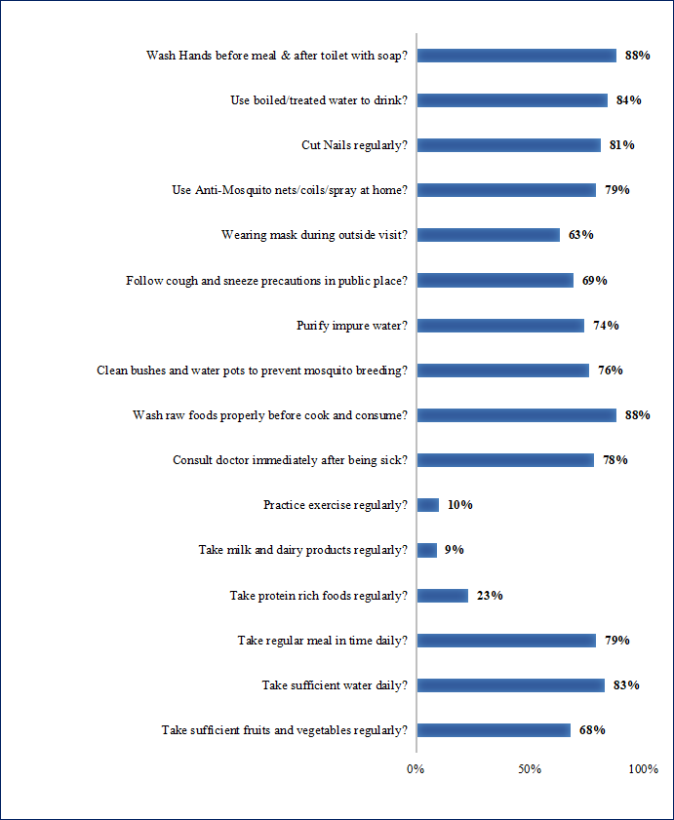
Figure 9: Percentage of responses about some regular health behaviours related to different diseases.
Results (Practices related information)

Slide 42
Results
Table 6: Know about the causative agents of Diarrheal Diseases.
Sl. No. | What are the causative agents of Diarrheal Diseases? | Percentage
1 | Bacteria | 39%
2 | Virus | 7%
3 | Bacteria and Virus both | 43%
4 | None of them | 1%
5 | Don't Know | 10%
Total |  | 100%

Slide 43
Results
Table 7: Know about how water borne diseases cause - by.
Water borne disease is caused by - | Percentage
Eating raw foods | 17%
Drinking polluted water | 64%
Eating restaurant foods | 11%
Taking water frequently | 3%
Drinking less water daily | 2%
None of the above | 3%
Total | 100%

Slide 44
Results
Figure 10 - % of respondents who purify water before use.
If Yes, How you purify Impure Water? | Percentage
Filter using cloths | 26%
Boiling | 35%
Using Fitkary | 30%
Using water treating tablet | 9%
Total | 100%

Slide 45
Results
Type of toilet you are using? | Percentage
Kachcha (Bamboo made) | 31%
Tin shed (shallow) | 59%
Open Space | 5%
Sanitary
 | 2%
Road/Canal/Lake side hanging toilet | 3%
Total | 100%
How do you wash your hands? With - | Percentage
Soap | 52%
Water Only | 15%
What available at home | 29%
Coal | 2%
Soil | 1%
Ashes | 1%
Total | 100%
How long you wash your hands? | Percentage
5 second | 4%
10 second | 22%
15 second | 28%
20 second | 46%
Total | 100%

Slide 46
Chapter # 02
Results
Objective: To estimate the disease burden/occurrence among the community people.

Slide 47
Results (Socio-Demographic Information)
Traits | N= 510
 | n | n%
Age
18 - 20 Year | 160 | 31.4
21 - 30 Years | 224 | 43.9
31 - 40 Years | 72 | 14.1
41 - 50 Years | 34 | 6.7
51 - 60 Years | 20 | 3.9
Gender
Male | 264 | 51.8
Female | 246 | 48.2
Educational status
Illiterate | 277 | 54.3
Primary Level | 205 | 40.2
Middle Level | 24 | 4.7
Graduate | 4 | .8
Occupational status
Housewife | 200 | 39.2
Daily Worker | 145 | 28.4
Unemployed | 37 | 7.3
Shopkeeper | 31 | 6.1
Student | 82 | 16.1
Temporary Job | 15 | 2.9
Monthly family income
Less than 3500 BDT | 157 | 30.8
3500 to 7000 BDT | 279 | 54.7
More than 7000 BDT | 74 | 14.5
Number of family members
1 to 4 persons | 136 | 26.7
5 to 8 persons | 331 | 64.9
More than 8 persons | 43 | 8.4

Slide 48
Results (n=510)
Table 1 - Awareness on Vitamin and Mineral deficiency disorder.
Any Vitamin deficiency disorder? | N= 510 |  | Any Mineral deficiency disorder? | N= 510
Options | n | n% | Options | n |  | n%
Yes | 228 | 45% | Yes | 230 |  | 45%
No | 156 | 30% | No | 122 |  | 24%
Not sure | 126 | 25% | Not sure | 158 |  | 31%
Total | 510 | 100% | Total | 510 |  | 100%
If yes, please mention. | n | n% | If yes, please mention. | n |  | n%
Vitamin A deficiency | 19 | 8% | Calcium deficiency | 53 |  | 23%
Vitamin B deficiency | 16 | 7% | Iodin deficiency | 37 |  | 16%
Vitamin C deficiency | 7 | 3% | Iron deficiency | 74 |  | 32%
Vitamin D deficiency | 30 | 13% | Zink deficiency | 17 |  | 8%
Vitamin E deficiency | 115 | 51% | Electrolyte Imbalance | 49 |  | 21%
Vitamin K deficiency | 41 | 18%
Total | 228 | 100% | Total | 230 | 100%

Slide 49
Results (n=510)
Table 2 - Communicable and non-communicable diseases are common in their area:
Which communicable diseases are common in your area? | N= 510 |  | Which non-communicable diseases are common in your area? | N= 510
Diseases | n | n% | Diseases | n | n%
Dengue, malaria, diarrhoea, allergy | 33 | 6% | Injury by accident | 33 | 7%
Diarrhea | 8 | 2% | Hypertension, Stroke | 31 | 6%
Malaria | 5 | 1% | Asthma, Anemia, DM | 29 | 6%
Scabies | 13 | 3% | Back Pain, CHD, Breathing Problem | 34 | 7%
Diarrhea, Malaria, TB, AIDS | 21 | 4% | Bronchitis, Cancer, Anemia | 30 | 6%
Skin disease | 112 | 22% | DM, CHD | 27 | 5%
viral disease | 15 | 3% | Daibetes Mellitus, Hypertension, Dislipidemia | 43 | 8%
Dysentary | 11 | 2% | Daibetes, Cencar, Anemia | 43 | 8%
Food Poisoning | 8 | 2% | Diabetes, Lung Disease | 58 | 11%
TB | 11 | 2% | Hypercholesterolemia, Hypertension | 31 | 6%
Dengue | 4 | 1% | Arthritis, Injury, Body Pain | 28 | 6%
Diarrhea, malaria, TB | 18 | 3% | Mental Disorder, Neuropathy, Arthritis | 34 | 7%
Aching pox | 77 | 15% | Not sure | 89 | 17%
Typhoid | 3 | 1%
Viral Cold and Fever | 103 | 20%
Diarrhea, TB, AIDS | 12 | 2%
Not sure | 56 | 11%

Slide 50
Table 9: Communicable & Non-Communicable Diseases suffering from (Diagnosed by last three months)
Results (n=510)
Non-Communicable Diseases suffering from | N= 510 |  | Communicable disease suffering from | N= 510
Diseases | n | n% | Diseases | n | n%
Diabetes Mellitus | 28 | 6% | Skin Infection | 112 | 22%
Stroke | 21 | 4% | Any Diarrheal disease | 101 | 20%
CHD | 37 | 7% | Helminthiasis | 27 | 5%
Anemia | 28 | 5% | Dengue | 13 | 3%
Dyslipidemia | 18 | 4% | Hepatitis B | 9 | 2%
Nephropathy | 9 | 2% | Malaria | 11 | 2%
Neuropathy | 13 | 3% | Pneumonia | 31 | 6%
Retinopathy | 15 | 3% | Covid-19 | 26 | 5%
Cataract | 27 | 5% | TB | 18 | 4%
Non-Viral Hepatitis | 12 | 2% | Typhoid | 10 | 2%
Mental Disorder | 26 | 5% | Viral Cold and Fever | 48 | 9%
IBS | 27 | 5% | Not sure | 104 | 20%
Arthritis | 23 | 5%
Back Pain | 25 | 5%
Gastric Ulcer | 18 | 4%
Thyroid problem | 12 | 2%
Rheumatic Fever | 19 | 4%
COPD | 16 | 3%
Calcium deficiency | 11 | 2%
Bronchitis | 2 | 0.50%
Osteoporosis | 21 | 4%
Injury by accident | 28 | 5%
Not sure | 74 | 15%

Slide 51
Table 10: Prevalence of Communicable & Non-Communicable Diseases.
Results (n=510)
Non-Communicable Diseases | Prevalence | Communicable Diseases | Prevalence
MI | 2.3 | Covid-19 | 0.04
Stroke | 1.1 | Dengue | 13
CHD | 1.1 | Diarrhea | 7
Diabetes Mellitus | 3 | Dysentary | 1
Iron deficiency | 12 | Food Poisoning | 0.04
Dyslipidemia | 0.45 | Helminthiasis | 11
Hypercholesterolemia | 2 | Cholera | 0
Neuropathy | 0.1 | Hepatitis B | 1
Retinopathy | 0.1 | Malaria | 0
Cataract | 1 | Pneumonia | 2
Non-Viral Hepatitis | 3.5 | Skin Infection | 19
Mental Disorder | 11 | TB | 0.05
Arthritis | 13 | Typhoid | 0.05
Osteoporosis | 4 | Viral Cold and Fever | 12
Rheumatic Fever | 1 | Hepatitis C | 2
Back Pain | 17 | Pox | 0
Gastric Ulcer | 7 | Mums | 0.07
Stomatitis | 1 | Measles | 0.08
Asthma | 6 | Oral Infection | 2
Calcium deficiency | 2 | Conjunctivitis | 3
Bronchitis | 3 | Rabies | 0.05
Angina Pactoris | 2 | Titanus | 0
Any Injury by accident | 4 | Scabies | 15
Anemia | 8 | UTI | 08
COPD | 11 | RTI | 07

Slide 52
Results (n=510)
Figure 1: Know about examples of Vitamins.

Slide 53
Results (n=510)
Figure 2: Know about examples of Minerals.

Slide 54
Results (n=510)
Figure 3: Know about rich sources of Vitamins & Minerals

Slide 55
Results (n=510)
Figure 4: Know about problems occur without Vitamins & Minerals in our body.

Slide 56
Chapter # 3
Results
Objective: To determine the impact of Health Education about different health issues including their health behavior, life style and health status of the respondents.

Slide 57
Results (Socio-Demographic Information)
Table 11: Socio-demographic information of the respondents
Traits | N= 510
 | n | n%
Age
< 20 Year | 160 | 31.4
21-30 Years | 224 | 43.9
31-40 Years | 72 | 14.1
41-50 Years | 34 | 6.7
51- 60 Years | 20 | 3.9
Gender
Male | 264 | 51.8
Female | 246 | 48.2
Educational status
Illiterate | 277 | 54.3
Primary Level | 205 | 40.2
Middle Level | 24 | 4.7
Graduate | 4 | .8
Occupational status
Housewife | 200 | 39.2
Daily Worker | 145 | 28.4
Unemployed | 37 | 7.3
Shopkeeper | 31 | 6.1
Student | 82 | 16.1
Temporary Job | 15 | 2.9
Monthly family income
Less than 3500 BDT | 157 | 30.8
3500 to 7000 BDT | 279 | 54.7
More than 7000 BDT | 74 | 14.5
Number of family members
1 to 4 persons | 136 | 26.7
5 to 8 persons | 331 | 64.9
More than 8 persons | 43 | 8.4

Slide 58
Results
Figure 1: Positive responses on impact of Health Education in improving knowledge on different Health Issues.

Slide 59
Results
Figure 2: Positive responses on impact of Health Education in changing some Health Behaviors.

Slide 60
Results
Figure 3: Positive responses on impact of Health Education in changing some Health-related attitude.

Slide 61
Results
Figure 4: Impact of Health Education in improving awareness on some Health Issues

Slide 62
Table 1: Association between the socio-demographic variable (Age group) with the health education system
Results
Questions | Do you know the health Workers? | Do they arrange Health Camp near you? | Do they teach you about Different Health Issues? | Do they guide you about practicing Sanitation & Hygiene? | Do they educate you about Communicable diseases? | Do you know about Diarrhea, Cholera, Typhoid & Hepatitis? | Do you know about HIV & other sexually transmitted diseases? | Do they provide you with charts, leaflets and brochure about different health issues?
Variables | Yes (n) | Yes (n) | Yes (n) | Yes (n) | Yes (n) | Yes (n) | Yes (n) | Yes (n)
Age
< 20 Year | 160 | 148 | 134 | 130 | 127 | 122 | 119 | 115
21-30 Years | 224 | 219 | 209 | 210 | 210 | 190 | 192 | 202
31-40 Years | 72 | 70 | 69 | 67 | 68 | 53 | 58 | 60
41-50 Years | 34 | 33 | 33 | 32 | 33 | 16 | 26 | 31
51- 60 Years | 20 | 20 | 20 | 20 | 19 | 12 | 15 | 18
P value | - | 0.082 | 0.001* | 0.001* | 0.001* | 0.001* | 0.078 | 0.001*

Slide 63
Table 2: Association between the socio-demographic variable (educational status) with the health education system
Results
Questions ► | Do you know the health Workers? | Do they arrange Health Camp near you? | Do they teach you about Different Health Issues? | Do they guide you about practicing Sanitation & Hygiene? | Do they educate you about Communicable diseases? | Do you know about Diarrhea, Cholera, Typhoid & Hepatitis? | Do you know about HIV & other sexually transmitted diseases? | Do they provide you with charts, leaflets and brochure about different health issues?
Options ► | Yes (n) | Yes (n) | Yes (n) | Yes (n) | Yes (n) | Yes (n) | Yes (n) | Yes (n)
Education
Illiterate | 277 | 273 | 277 | 276 | 274 | 237 | 254 | 270
Primary Level | 205 | 190 | 167 | 163 | 162 | 142 | 140 | 142
Middle Level | 24 | 23 | 18 | 17 | 18 | 11 | 13 | 11
Graduate | 4 | 4 | 3 | 3 | 3 | 3 | 3 | 3
P value | - | 0.012* | 0.001* | 0.001* | 0.001* | 0.001* | 0.872 | 0.001*

Slide 64
Table 3: Association between the socio-demographic variable (Occupation) with the health education system
Results
Questions ► | Do you know the health Workers? | Do they arrange Health Camp near you? | Do they teach you about Different Health Issues? | Do they guide you about practicing Sanitation & Hygiene? | Do they educate you about Communicable diseases? | Do you know about Diarrhea, Cholera, Typhoid & Hepatitis? | Do you know about HIV & other sexually transmitted diseases? | Do they provide you with charts, leaflets and brochure about different health issues?
Options ► | Yes (n) | Yes (n) | Yes (n) | Yes (n) | Yes (n) | Yes (n) | Yes (n) | Yes (n)
Occupation
Housewife | 200 | 193 | 186 | 185 | 183 | 161 | 166 | 170
Daily Worker | 145 | 137 | 133 | 132 | 132 | 122 | 125 | 130
Unemployed | 37 | 37 | 35 | 34 | 35 | 23 | 28 | 30
Shopkeeper | 31 | 30 | 29 | 27 | 28 | 24 | 26 | 28
Student | 82 | 79 | 67 | 66 | 64 | 55 | 56 | 55
Job | 15 | 14 | 15 | 15 | 15 | 8 | 9 | 13
P value | - | 0.709 | 0.032* | 0.872 | 0.008* | 0.002* | 0.006* | 0.001***

Slide 65
Table 4: Association between the socio-demographic variable (Age group) with attitudes towards health education system
Results
Questions ► | Do you think Health Education made change your attitude about Sanitation & Hygiene practices? | Do you think Health Education helped you to prevent some communicable diseases? | Do you think Health Education increased your knowledge and awareness about Sanitation, Hygiene, some diseases and about good health behavior? | Do you think Health Education helped you to prevent some non-communicable diseases?
Options ► | Yes (n) | Yes (n) | Yes (n) | Yes (n)
Age
< 20 Year | 123 | 127 | 131 | 129
21-30 Years | 206 | 209 | 212 | 185
31-40 Years | 67 | 66 | 68 | 51
41-50 Years | 33 | 33 | 31 | 15
51- 60 Years | 20 | 19 | 19 | 11
P value | 0.001*** | 0.001*** | 0.001*** | 0.001***

Slide 66
Table 5: Association between the socio-demographic variable (educational status) with attitudes towards health education system
Results
Questions ► | Do you think Health Education made change your attitude about Sanitation & Hygiene practices? | Do you think Health Education helped you to prevent some communicable diseases? | Do you think Health Education increased your knowledge and awareness about Sanitation, Hygiene, some diseases and about good health behavior? | Do you think Health Education helped you to prevent some non-communicable diseases?
Options ► | Yes (n) | Yes (n) | Yes (n) | Yes (n)
Educational Status
Illiterate | 275 | 273 | 273 | 230
Primary Level | 152 | 158 | 166 | 144
Middle Level | 20 | 19 | 18 | 13
Graduate | 2 | 4 | 4 | 4
P value | .001*** | .001*** | .001*** | .001***

Slide 67
Results
Table 6 - Association between the socio-demographic variable (Occupation) with attitudes towards health education system:
Questions► | Do you think Health Education made change your attitude about Sanitation & Hygiene practices? | Do you think Health Education helped you to prevent some communicable diseases? | Do you think Health Education increased your knowledge and awareness about Sanitation, Hygiene, some diseases and about good health behavior? | Do you think Health Education helped you to prevent some non- communicable diseases?
Options► | Yes(n) | Yes(n) | Yes(n) | Yes(n)
Occupational Status
Housewife | 178 | 179 | 178 | 149
DailyWorker | 127 | 132 | 131 | 122
Unemployed | 34 | 33 | 34 | 25
Shopkeeper | 27 | 27 | 30 | 28
Student | 69 | 68 | 73 | 63
Job | 14 | 15 | 15 | 4
P value | 0.904 | 0.396 | 0.569 | 0.001***

Slide 68
Chapter # 4
Results
Objective: To reveal the socio-demographic factors associated with different diseases (both communicable and non-communicable) of the respondents.

Slide 69
Table 1: Socio-demographic information (age, gender, and educational status) of the respondents:
Variables | Water Borne Diseases (N=504) | Tuberculosis (N=523) | Mosquito Borne Diseases (N=511) | Hypertension (N=504) | Diabetes Mellitus (N=517) | Iron deficiency Anemia (N=501)
 | n% | n% | n% | n% | n% | n%
Age
18 - 20 Year | 34.9 | 12.2 | 15.7 | 11.3 | 33.7 | 37
21-30 Years | 37.1 | 46.1 | 38.8 | 48.6 | 24.4 | 34
31-40 Years | 15.7 | 31.0 | 25.9 | 25.8 | 15.7 | 18
41-50 Years | 6.3 | 7.6 | 12.2 | 10.1 | 9.9 | 6
51- 60 Years | 3.6 | 2.7 | 5.9 | 3.2 | 4.6 | 2
>60+ Years | 2.4 | .4 | 1.6 | 1.0 | 11.8 | 3
Gender
Male | 50.2 | 61.4 | 52.7 | 53.0 | 54.4 | 0
Female | 49.8 | 38.6 | 47.3 | 47.0 | 45.6 | 100
Education
Illiterate | 39.1 | 52.8 | 73.3 | 50.6 | 74.7 | 57
Primary Level | 51.8 | 45.5 | 23.9 | 47.6 | 22.8 | 43
Middle Level | 8.7 | 1.7 | 2.5 | 1.6 | 1.7 | 0
Graduate | .4 | 0 | .2 | .2 | .8 | 0

Slide 70
Table 1: Continue:
Variables | Water Borne Diseases (N=504) | Tuberculosis (N=523) | Mosquito Borne Diseases (N=511) | Hypertension (N=504) | Diabetes Mellitus (N=517) | Iron deficiency Anemia (N=501)
 | n% | n% | n% | n% | n% | n%
Occupation
Housewife | 32.9 | 39.0 | 43.1 | 45.6 | 43.1 | 79%
Daily Worker | 29.6 | 44.4 | 32.9 | 33.5 | 41.6 | 9%
Unemployed | 7.1 | 4.8 | 8.4 | 4.2 | 6.6 | 2%
Shopkeeper | 7.5 | 6.9 | 7.1 | 8.3 | 5.4 | 2%
Student | 19.0 | 3.4 | 6.5 | 5.2 | 2.7 | 5%
Job | 3.8 | 1.5 | 2.0 | 3.2 | .6 | 3%
Marital status
Married | 41.7 | 84.7 | 77.1 | 85.1 | 81.6 | 81%
Single | 55.4 | 12.8 | 20.0 | 12.7 | 17.6 | 18%
Widow/widower/divorced | 3.0 | 2.5 | 2.9 | 2.2 | .8 | 1%
Monthly family income (BDT)
<3.5K | 23.2 | 18.2 | 24.5 | 23.8 | 20.7 | 21%
3.5K to 7K | 62.9 | 74.0 | 60.4 | 57.5 | 63.4 | 64%
>7K | 13.9 | 7.8 | 15.1 | 18.7 | 15.9 | 15%
Number of family members (persons)
1 to 4 | 21.0 | 37.3 | 43.5 | 36.9 | 38.7 | 29%
5 to 8 | 65.9 | 57.9 | 47.5 | 51.0 | 47.8 | 66&
>8 | 13.1 | 4.8 | 9.0 | 12.1 | 13.5 | 5%

Slide 71
Table 2: Association between socio-demographic variables with knowledge, attitude and practices on Diarrhea.
Variables | Knowledge part |  | Practice part |  | Attitude part
 | Do you know about diarrhea? | Do you know the causative agents of Diarrhea? | Do you wash your hands before eating with soap? | Do you wash your hands after defecation with soap? | Do you use sanitary latrine? | Do you use clean water & follow safe sanitation? | Is Diarrhea cured by drugs and proper management? | Is Diarrhea preventable?
 | Yes (n) | Yes (n) | Yes (n) | Yes (n) | Yes (n) | Yes (n) | Yes (n) | Yes (n)
Age
< 20 Year | 172 | 107 | 174 | 166 | 145 | 173 | 161 | 173
21-30 Years | 180 | 133 | 185 | 183 | 153 | 183 | 175 | 184
31-40 Years | 73 | 51 | 78 | 72 | 56 | 78 | 75 | 78
41-50 Years | 29 | 22 | 32 | 27 | 27 | 31 | 30 | 31
51- 60 Years | 17 | 14 | 18 | 15 | 16 | 17 | 18 | 17
>60+ Years | 10 | 8 | 12 | 12 | 11 | 12 | 11 | 11
P value | 0.079 | 0.347 | 0.981 | 0.021* | 0.193 | 0.857 | 0.756 | 0.507
Gender
Male | 240 | 159 | 251 | 243 | 207 | 249 | 225 | 245
Female | 241 | 176 | 248 | 232 | 201 | 245 | 245 | 249
P value | 0.535 | 0.084 | 0.647 | 0.218 | 0.619 | 0.515 | 0.001*** | 0.507
Education
Illiterate | 194 | 151 | 197 | 185 | 194 | 195 | 195 | 195
Primary Level | 242 | 151 | 256 | 249 | 194 | 255 | 239 | 254
Middle Level | 43 | 31 | 44 | 39 | 19 | 42 | 35 | 43
Graduate | 2 | 2 | 2 | 2 | 1 | 2 | 1 | 2
P value | 0.026* | 0.000*** | 0.195 | 0.066 | 0.000*** | 0.456 | 0.000*** | 0.645

Slide 72
Table 2 continue:
Variables | Knowledge part |  | Practice part |  |  |  | Attitude part
 | Do you know about diarrhea? | Do you know the causative agents of Diarrhea? | Do you wash your hands before eating with soap? | Do you wash your hands after defecation with soap? | Do you use sanitary latrine? | Do you use clean water & follow safe sanitation? | Is Diarrhea cured by drugs and proper management? | Is Diarrhea preventable?
 | Yes (n) | Yes (n) | Yes (n) | Yes (n) | Yes (n) | Yes (n) | Yes (n) | Yes (n)
Monthly family income (BDT)
< 3.5K | 101 | 65 | 114 | 111 | 71 | 112 | 102 | 111
3.5K to 7K | 310 | 215 | 315 | 296 | 274 | 312 | 301 | 314
>7K | 70 | 55 | 70 | 68 | 63 | 70 | 67 | 69
P value | .001*** | 0.004* | 0.131 | 0.752 | 0.001*** | 0.089 | 0.011* | 0.020*
Number of family members (persons)
1 to 4 | 98 | 70 | 104 | 96 | 84 | 104 | 97 | 100
5 to 8 | 320 | 220 | 331 | 317 | 278 | 324 | 312 | 329
> 8 | 63 | 45 | 64 | 62 | 46 | 66 | 61 | 65
P value | 0.240 | 0.950 | 0.072 | 0.031* | 0.026* | 0.438 | 0.650 | 0.009*

Slide 73
Table 3: Association between demographic variables with knowledge, attitude and practices on TB.
Variables | Knowledge Part |  | Practice Part |  |  |  | Attitude Part
 | Do you know what TB is? | Do you think personal hygiene decrease TB risk? | Do you think TB is a result of great sin? | Do you cough in public place without carefulness? | Do you know what TB is? | Do you think personal hygiene decrease TB risk? | Do you think TB is a result of great sin? | Do you cough in public place without carefulness?
 | Yes (n) | Yes (n) | Yes (n) | Yes (n) | Yes (n) | Yes (n) | Yes (n) | Yes (n)
Age
< 20 Year | 48 | 28 | 50 | 42 | 22 | 28 | 20 | 43
21-30 Years | 180 | 107 | 172 | 155 | 78 | 121 | 65 | 173
31-40 Years | 98 | 83 | 100 | 85 | 55 | 95 | 67 | 107
41-50 Years | 25 | 24 | 29 | 24 | 18 | 28 | 20 | 30
51- 60 Years | 9 | 14 | 12 | 10 | 11 | 12 | 1 | 12
>60+ Years | 1 | 1 | 2 | 1 | 0 | 2 | 1 | 2
P value | 0.043* | 0.008 | 0.073 | 0.196 | 0.009 | 0.005 | 0.002 | 0.441
Gender
Male | 224 | 149 | 215 | 190 | 120 | 209 | 130 | 219
Female | 137 | 108 | 150 | 127 | 64 | 77 | 44 | 148
P value | 0.637 | 0.362 | 0.078 | 0.402 | 0.184 | 0.001*** | 0.001* | 0.220
Education
Illiterate | 208 | 185 | 222 | 181 | 133 | 170 | 94 | 207
Primary Level | 151 | 69 | 140 | 131 | 48 | 116 | 78 | 154
Middle Level | 2 | 3 | 3 | 5 | 3 | 0 | 2 | 6
Graduate | - | - | - |  | - | - | - | -
P value | 0.001*** | 0.001*** | 0.001*** | 0.049* | 0.001*** | 0.001*** | 0.741 | 0.038*

Slide 74
Table 3 continue:
Variables | Knowledge Part |  | Practice Part |  |  |  | Attitude Part
 | Do you know what TB is? | Do you think personal hygiene decrease TB risk? | Do you think TB is a result of great sin? | Do you cough in public place without carefulness? | Do you know what TB is? | Do you think personal hygiene decrease TB risk? | Do you think TB is a result of great sin? | Do you cough in public place without carefulness?
 | Yes (n) | Yes (n) | Yes (n) | Yes (n) | Yes (n) | Yes (n) | Yes (n) | Yes (n)
Monthly family income (BDT)
< 3.5K | 61 | 49 | 53 | 50 | 36 | 58 | 46 | 44
3.5K to 7K | 272 | 189 | 286 | 245 | 136 | 204 | 111 | 298
>7K | 28 | 19 | 26 | 22 | 12 | 24 | 17 | 25
P value | 0.220 | 0.693 | 0.002* | 0.103 | 0.626 | 0.300 | 0.002* | 0.001***
Number of family members (persons)
1 to 4 | 12 | 81 | 138 | 125 | 60 | 102 | 57 | 134
5 to 8 | 97 | 167 | 208 | 174 | 116 | 175 | 109 | 215
> 8 | 17 | 9 | 19 | 18 | 8 | 9 | 8 | 18
P value | 0.802 | 0.003* | 0.693 | 0.162 | 0.217 | 0.077 | 0.294 | 0.850

Slide 75
Table 4: Association between socio-demographic variables with knowledge, attitude and practices on HTN.
Variables | Knowledge Part |  | Attitude Part |  | Practice Part
 | Do you know about Hypertension? | Do you know the causes of Hypertension? | Do you think Hypertension can be cured by drugs & are preventable? | Do you think regular exercise can reduce the chance of Hypertension? | Do you check your BP regularly? | Do you avoid oily or fat rich foods?
 | Yes (n) | Yes (n) | Yes (n) | Yes (n) | Yes (n) | Yes (n)
Age
< 20 Year | 53 | 53 | 49 | 54 | 32 | 44
21-30 Years | 210 | 204 | 225 | 224 | 110 | 228
31-40 Years | 96 | 96 | 117 | 106 | 55 | 120
41-50 Years | 31 | 30 | 45 | 43 | 23 | 43
51- 60 Years | 13 | 11 | 14 | 16 | 8 | 15
>60+ Years | 4 | 4 | 4 | 4 | 3 | 5
P value | 0.001*** | 0.001*** | 0.729 | 0.016* | 0.593 | 0.005
Gender
Male | 223 | 215 | 241 | 239 | 132 | 243
Female | 184 | 183 | 213 | 208 | 99 | 212
P value | 0.094 | 0.363 | 0.884 | 0.536 | 0.085 | 0.555
Education
Illiterate | 183 | 178 | 221 | 222 | 131 | 234
Primary Level | 215 | 213 | 224 | 219 | 97 | 214
Middle Level | 8 | 6 | 8 | 5 | 3 | 6
Graduate | 1 | 1 | 1 | 1 | 0 | 1
P value | 0.001*** | 0.001*** | 0.067 | 0.049* | 0.070 | 0.360

Slide 76
Table 4 continue:
Variables | Knowledge Part |  | Attitude part |  | Practice Part
 | Do you know about Hypertension? | Do you know the causes of Hypertension? | Do you think Hypertension can be cured by drugs & are preventable? | Do you think regular exercise can reduce the chance of Hypertension? | Do you check your BP regularly? | Do you avoid oily or fat rich foods?
 | Yes (n) | Yes (n) | Yes (n) | Yes (n) | Yes (n) | Yes (n)
Occupation
Housewife | 173 | 173 | 209 | 197 | 93 | 208
Daily Worker | 138 | 134 | 151 | 153 | 89 | 159
Unemployed | 16 | 15 | 14 | 21 | 10 | 17
Shopkeeper | 40 | 38 | 41 | 39 | 17 | 39
Student | 26 | 26 | 24 | 24 | 19 | 16
Job | 14 | 12 | 15 | 13 | 3 | 16
P value | .004 | .022* | .198 | .006 | .002 | .001***
Type of family
Nuclear | 223 | 212 | 277 | 267 | 132 | 279
Joint | 184 | 186 | 177 | 180 | 99 | 176
P value | .001*** | .001*** | .492 | .022* | .064 | .790
Marital status
Married | 342 | 333 | 385 | 377 | 184 | 400
Single | 60 | 62 | 60 | 60 | 42 | 45
Widow/widower/divorced | 5 | 3 | 9 | 10 | 5 | 10
P value | 0.001*** | 0.001*** | 0.395 | 0.374 | 0.003* | 0.363

Slide 77
Table 5: Association between socio-demographic variables with knowledge, attitude and practices on IDA.
Variables | Knowledge Part |  | Attitude part |  | Practice Part
 | Do you know about Iron-deficiency Anemia? | Do you think proper diet & taking essential nutrients can prevent Anemia? | Do you take Iron rich foods? | Do you know about Iron-deficiency Anemia? | Do you think proper diet & taking essential nutrients can prevent Anemia? | Do you take Iron rich foods?
 | Yes (n) | Yes (n) | Yes (n) | Yes (n) | Yes (n) | Yes (n)
Age
< 20 Year | 51 | 54 | 48 | 53 | 31 | 43
21-30 Years | 210 | 204 | 223 | 223 | 109 | 225
31-40 Years | 96 | 95 | 117 | 105 | 55 | 123
41-50 Years | 31 | 30 | 45 | 43 | 23 | 43
51- 60 Years | 13 | 11 | 14 | 17 | 8 | 15
>60+ Years | 3 | 4 | 4 | 4 | 4 | 5
P value | 0.001*** | 0.001*** | 0.729 | 0.016* | 0.593 | 0.005
Education
Illiterate | 182 | 176 | 221 | 220 | 131 | 231
Primary Level | 215 | 213 | 224 | 219 | 97 | 214
Middle Level | 8 | 6 | 8 | 5 | 3 | 6
Graduate | 1 | 1 | 1 | 1 | 0 | 1
P value | 0.001*** | 0.001*** | 0.067 | 0.049* | 0.070 | 0.360

Slide 78
Table 5 continue:
Variables | Knowledge Part |  | Attitude Part |  | Practice Part
 | Do you know about Iron-deficiency Anemia? | Do you think proper diet & taking essential nutrients can prevent Anemia? | Do you take Iron rich foods? | Do you know about Iron-deficiency Anemia? | Do you think proper diet & taking essential nutrients can prevent Anemia? | Do you take Iron rich foods?
 | Yes (n) | Yes (n) | Yes (n) | Yes (n) | Yes (n) | Yes (n)
Occupation
Housewife | 170 | 171 | 207 | 195 | 91 | 205
Daily Worker | 138 | 134 | 151 | 153 | 89 | 159
Unemployed | 16 | 15 | 14 | 21 | 10 | 17
Shopkeeper | 40 | 38 | 41 | 39 | 17 | 39
Student | 26 | 26 | 24 | 24 | 19 | 16
Job | 14 | 12 | 15 | 13 | 3 | 16
P value | 0.004 | 0.022* | 0.006 | 0.198 | 0.002 | 0.001***
Type of family
Nuclear | 220 | 212 | 274 | 264 | 132 | 276
Joint | 184 | 186 | 177 | 180 | 99 | 176
P value | 0.001*** | 0.001*** | 0.492 | 0.022* | 0.064 | 0.790
Marital status
Married | 342 | 330 | 382 | 374 | 184 | 400
Single | 60 | 62 | 60 | 60 | 42 | 45
Widow/widower/divorced | 5 | 3 | 9 | 10 | 5 | 10
P value | 0.001*** | 0.001*** | 0.395 | 0.374 | 0.003* | 0.363

Slide 79
Discussions
This Study | Other Study
To satisfy the requirement of the study objectives a cross-sectional survey was conducted on 3060 Rohingya people living in the refugee camps at Cox’s bazar in Bangladesh.
This study has male-to-female participants with an average ratio of 51:49 towards knowledge, attitudes and practices towards communicable and non-communicable diseases | A Jordanian study on the refugee population was slightly different, where the gender ratio was 39:61 (Kimbrough et al., 2022).
This study showed that 84% of participants have the knowledge and 78% has positive attitudes towards water-borne diseases | A Lebanese study on the refugee settlement both have lower knowledge, 22% and a less positive attitude, 8% towards water-borne diseases (Malaeb et al., 2022).
This study showed that young age (21-30) years participants mostly thought that health education could help to prevent diseases from spreading (p<.001). | A similar study on the same population showed that similar age populations had thought about health education. (Shohel, 2022)

Slide 80
Discussions
Gaining insight into the epidemiology of diseases among the FDMN community is essential for implementing effective healthcare interventions.
An analysis of the frequency, occurrence, and spread of different diseases can offer valuable understanding of the health difficulties experienced by this susceptible group.
Overpopulation, restricted availability of potable water, and insufficient sanitary infrastructure can potentially facilitate the transmission of contagious illnesses.

Slide 81
Discussions
Socio-demographic characteristics such as age, gender, education, and socio-economic position exert a substantial influence on health outcomes.
Women and children may have unique health obstacles compared to adult males. It is a matter of importance to focus on women and children more to ensure health care facilities, fundamental needs and needs during emergency.
Health education initiatives have the potential to significantly enhance health habits, lifestyles, and overall health status among the FDMN community.

Slide 82
Conclusion
This study offer significant insights into the understanding and behaviors pertaining to both communicable and non-communicable diseases within the Rohingya people in Cox’s Bazar Camp.
The study has revealed noteworthy correlations between socio-demographic variables, knowledge pertaining to health education, and individuals' attitudes towards health education.
This study offer significant insights into the knowledge and awareness on different diseases, health behaviors, ideas on nutrients, their sources, malnutrition and linked factors.
The study provides a comprehensive analysis of the Socio-Demographic factors influencing the prevalence of communicable and non-communicable diseases within the Rohingya population.

Slide 83
Recommendations and Future perspectives
There is no alternative of training and health education regarding different health issues among different community people.
As Rohingya people are vulnerable and living with limited resourses, awareness and health education programs should be continued.
Awareness of different diseases, lifestyle and food havit is important through social, NGO and Govt. interventions.
Health promotion, health care distribution, emergency response etc. may play major role in reducing spreading diseases and epidemics.
So regular health check up/diagnosis, regular medication, regular monitoring on various health issues should be recommended.
Regular awareness program, KAP studies, awareness based chapters in academic course should be implemented.
Should iImprove the sanitation condition of the camps with the availability of sufficient drinking water.
Different local & global NGOs and local Government should raise more funds for the Rohingya refugees to meet their needs.
As the research carried out in a fixed refugee camp settings, caution be exercised to apply to other refugee populations.

Slide 84
Limitation of the Study
It is imperative to acknowledge the limitations of the study and take them into account when interpreting the results
Additional research is required in various refugee settings to support and build upon the existing discoveries,
thereby inspiring the efficacy of healthcare interventions for marginalized populations on a global scale.
Moreover, it is important to consider the potential influence of self-reporting bias on the respondents' answers,
as this could have implications for the accuracy and reliability of the collected data.

Slide 85
References…………
[1]. Ahmed S, Kim MH, Dave AC, Et Al. Handwashing Practice And Challenges In Bangladesh. Int J Environ Health Res. 2017;27(5):435- 451. Doi:10.1080/09603123.2017.1322400.
[2]. Ali M, Et Al. (2020). Dengue Outbreak In Rohingya Refugee Camps In Bangladesh: An Analysis Of Surveillance Data. Plos Neglected Tropical Diseases, 14(3), E0008163.
[3]. Doocy S, Lyles E, Akhu-Zaheya L, Et Al. Gender And Preference For Treatment During Conflict And Non-Conflict Periods In Darfur. Disasters. 2018;42(3):421-438. Doi:10.1111/Disa.12268.
[4]. Islam MR, Et Al. (2019). Tuberculosis Among Rohingya Refugees: Findings From The First Year Of Surveillance In Cox's Bazar, Bangladesh. Plos Medicine, 16(11), E1002954.
[5]. Islam T, Mahari S, Ahammed B, Et Al. Prevalence Of Tuberculosis And Health-Related Quality Of Life Among Rohingya Refugees In Cox’s Bazar, Bangladesh. J Glob Health. 2019.
[6]. Khatun F, Et Al. (2021). The COVID-19 Pandemic Among Rohingya Refugees In Bangladesh: Impact And Preparedness. Journal Of Migration And Health, 2, 100025.
[7]. Kouzmina E, Et Al. (2020). A Systematic Review Of The Impact Of Routine Collection Of Patient-Reported Outcome Measures On Patients, Providers, And Health Organizations In An Oncologic Setting. BMC Health Services Research, 20, 987.
[8]. Rahman MS, Et Al. (2021). Non-Communicable Disease (NCD) Awareness Among The Rohingyas: A Qualitative Study In Refugee Camps, Bangladesh. PLOS ONE, 16(1), E0246041.
[9]. Sarker AR, Et Al. (2017). Prevalence And Risk Factors Of Diarrheal Diseases Among Children Under Five Years Of Age In Rohingya Refugee Camps, Bangladesh, 2017. Plos ONE, 12(11), E0186571.
Many more ..................

Slide 86
ACKNOWLEDGEMENTS
Paying gratitude to the most Gracious, most Merciful, and Creator of this Universe the Almighty Allah (SWT)
Gratitude must be to my beloved parents, who have patiently supported me throughout my education from the very beginning to till date
I wish to express my deepest sense of gratitude to my supervisor Professor Dr. Mohammad Alamgir Hossain
I would like to express my sincere gratitude to my co-supervisor, Professor Dr. AMAM Zonaed Siddiki
I would like to express my sincere gratitude to my co-supervisor, Professor Dr. Sharmin Chowdhury
I offer my heartiest honor to Prof. Dr. Md Masuduzzaman, Prof. Dr. Md Abdul Alim and other faculty members.
I would like to express my sincere gratitude to UGC, IQAC and CASR of CVASU.
I have my highest regards to all the administrative officers, office staffs and other subjects of different departments.
My highest regards to the subjects who consented without hesitation and gave their valuable time to volunteer in this research work.
I would like to express my sincere gratitude to the respondents who provided important information during collecting data.

Slide 87
Question?

Slide 88
Thank You Very Much
for
Your Kind Attention

