Slide 1
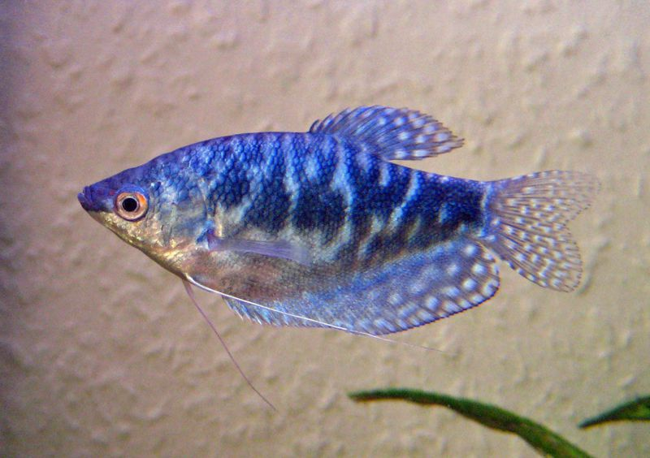

Welcome To My Presentation
Presented by :
Mohammad Abu Naeem
MS Fellow
Roll No. : 0119/09
Reg. No. : 727
Department of Fisheries Resource Management

Slide 2
EFFECTS OF NATURAL CAROTENOIDS ON THE BODY COLORATION OF BLUE GOURAMI FISH (Trichogaster trichopterus)
Supervisor Shahida Arfine Shimul Assistant Professor Department of Fisheries Resource Management Faculty of Fisheries CVASU | Co-supervisor Dr. Sk. Ahmad Al Nahid Associate Professor and Head Department of Fisheries Resource Management Faculty of Fisheries CVASU

Slide 3
INTRODUCTION
Blue gourami (Trichogaster trichopterus) is a new fish in aquaculture, used in hobbies and marketed all over the world.
Attractive coloration determines the commercial value of ornamental fish.
Carotenoids are the primary source of color in the skin of the ornamental fishes
Coloration may be improve in several ways in case of ornamental fishes such as feed, background color, light, maintenance of favorable water pH and temperature etc.

Slide 4

To improve coloration of the blue gourami fish.
To increase market and aesthetic value of blue gourami fish.

Slide 5
Materials & Methods

Slide 6
Study Site:
CVASU Wet Lab & Ecology Lab
Duration of Research:
4 months (120 days) (September to December, 2019)
Feed type: Formulated & natural carotenoid enriched feed.
Quantity: 5% of the total biomass in each tank.
Water Quality Parameters :
DO: 5-7 PPM
pH: 7-8.5
Water temp.: 24-28 ⁰C

Slide 7
Experimental Layout
Dietary treatment groups | Treatment × Replication (T_{n}× R_{n}) | No. of fishes per tank | Total no. of fish per treatments
T₀ (100% Commercial feed, without natural carotenoid mixing group) | T₀R₁ (Tank no.01) | 08 | 24
 | T₀R₂ (Tank no.02) | 08
 | T₀R₃ (Tank no.03) | 08
T₁ (15% China rose flower mixed) | T₁R₁(Tank no.04) | 08 | 24
 | T₁R₂ (Tank no.05) | 08
 | T₁R₃ (Tank no.06) | 08
T₂ (15% Marigold flower mixed) | T₂R₁ (Tank no.07) | 08 | 24
 | T₂R₂ (Tank no.08) | 08
 | T₂R₃ (Tank no.09) | 08
T₃ ( 15% Carrot mixed) | T₃R₁ (Tank no.10) | 08 | 24
 | T₃R₂ (Tank no.11) | 08
 | T₃R₃ (Tank no.12) | 08

Slide 8
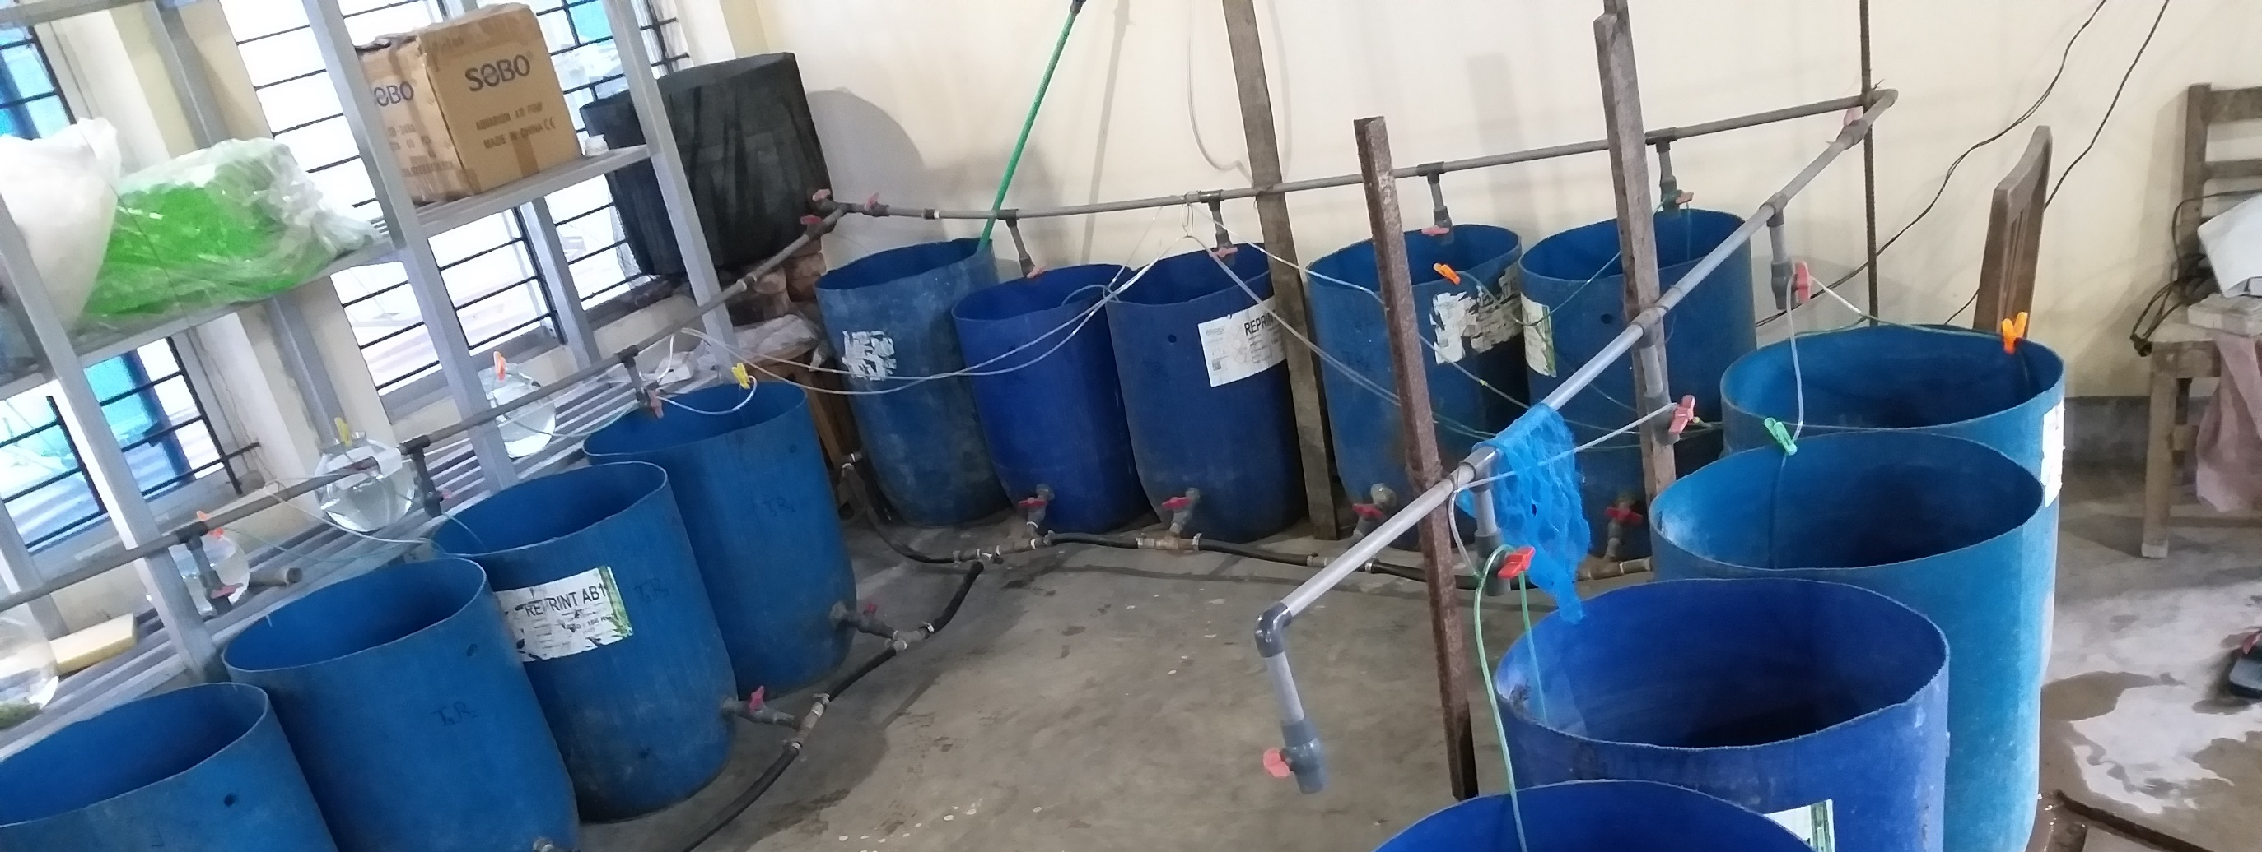
Experimental Setup

Slide 9
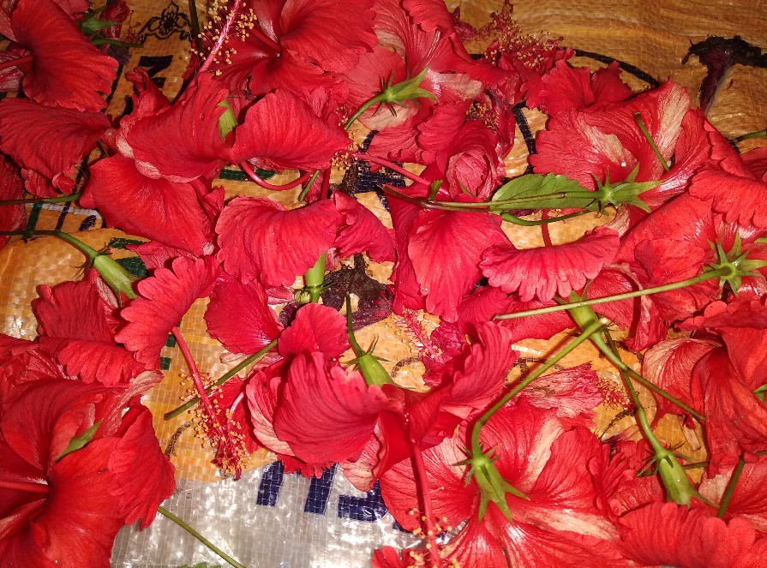
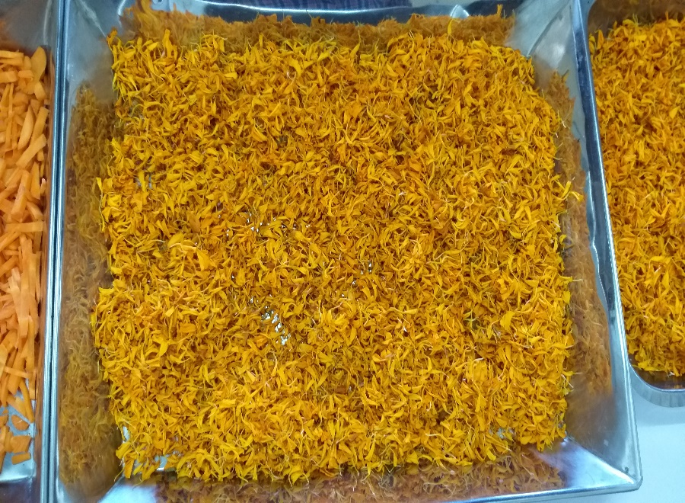
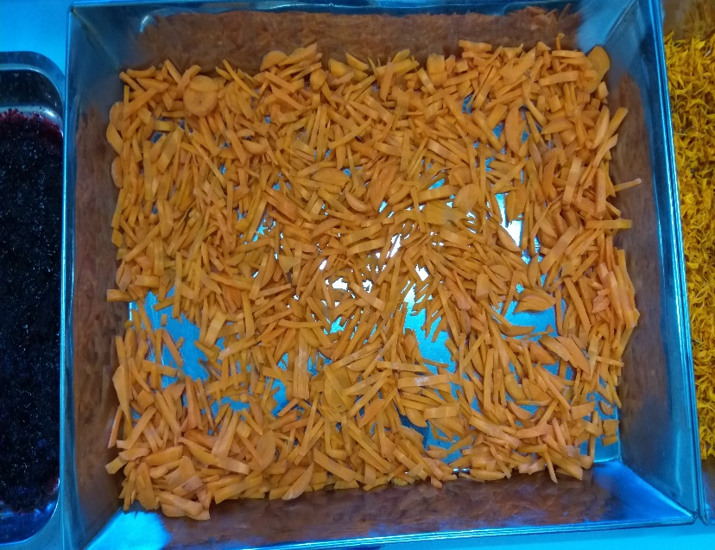
Raw Ingredients
China Rose Flower(Hibiscus rosa-sinensis)
Marigold Flower (Tagetes erecta)
Carrot (Daucus carota)

Slide 10
Proximate Analysis of Feed Ingredients
Sl. No. | Ingredients Name | Protein (%) | Lipid (%) | Ash (%) | Moisture (%) | Carotenoid Value (mg/100g)
1. | Commercial feed | 30 | 6 | 16 | 12 | 0.007
2. | China Rose Flower | 15.7 | 6.8 | 6.2 | 71.02 | 0.0290
3. | Carrot | 22 | 8.7 | 5.6 | 75.54 | 0.0960
4. | Marigold Flower | 12.3 | 9.3 | 7.21 | 68.05 | 0.73

Slide 11
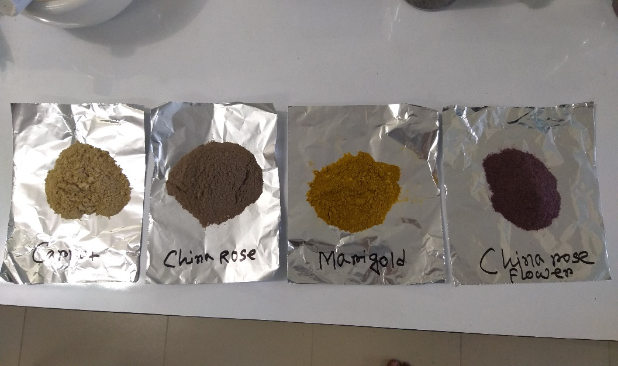
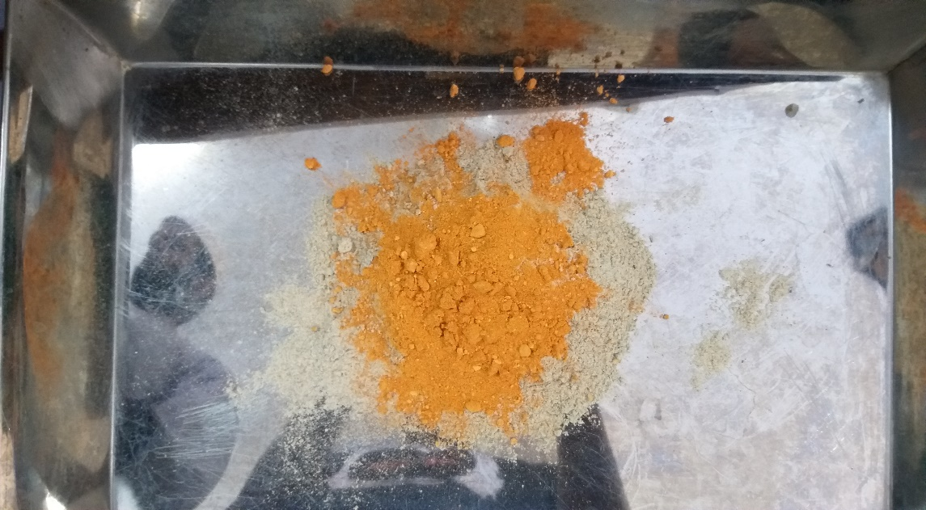
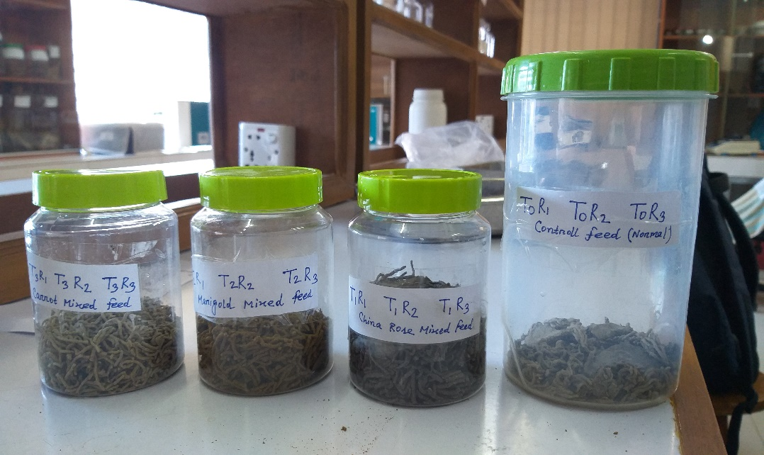
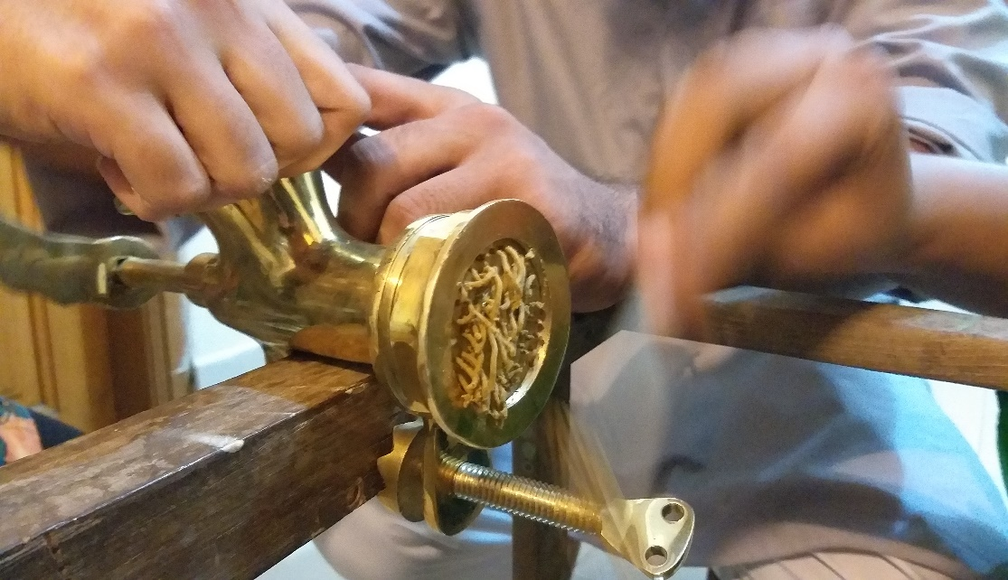
Experimental Feed Preparation

Slide 12
Proximate Analysis of Experimental Feed
Content | T₀ (Commercial feed) | T₁ (China Rose Mixed Feed) | T₂ (Marigold Mixed Feed) | T₃ (Carrot Mixed Feed)
Protein % | 30 | 27.82 | 27.34 | 28.8
Lipid % | 06 | 5.47 | 5.11 | 5.58
Ash % | 16 | 14.53 | 14.681 | 14.44
Moisture % | 12 | 11.38 | 11.47 | 12.24

Slide 13
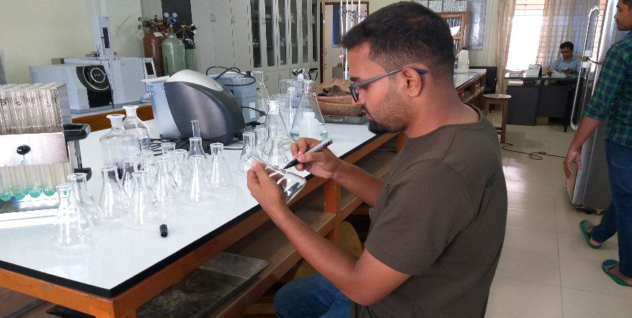
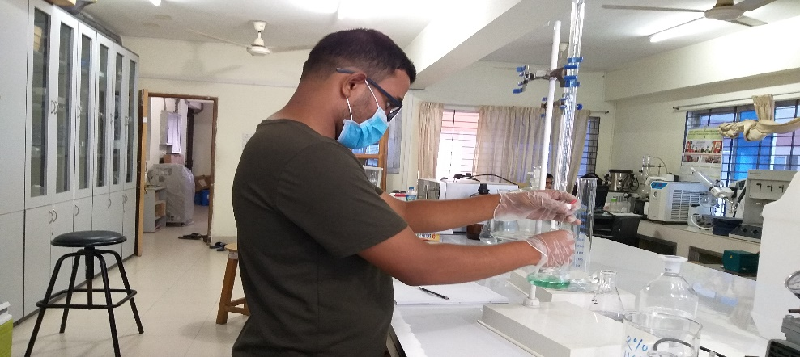
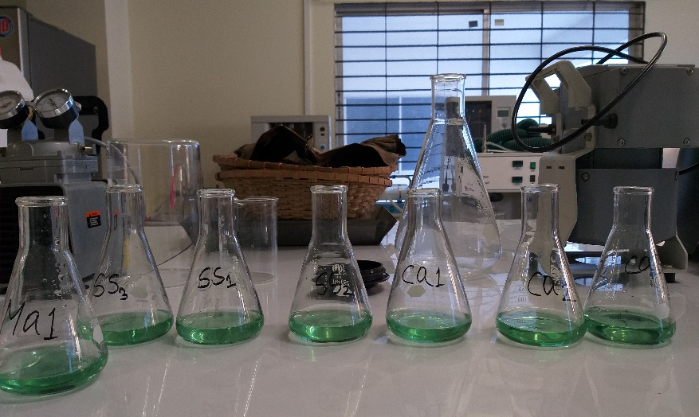
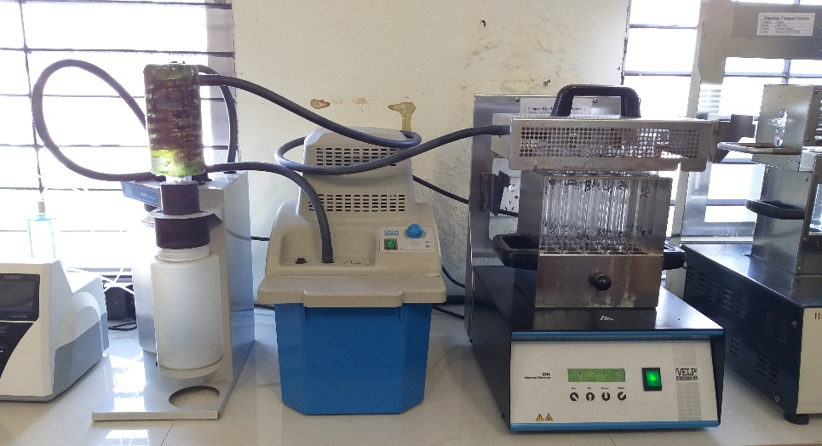
Proximate Analysis of Experimental Feed

Slide 14
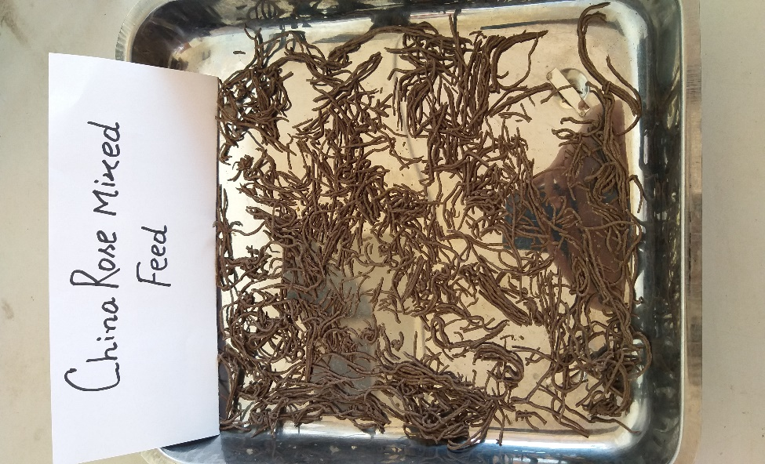
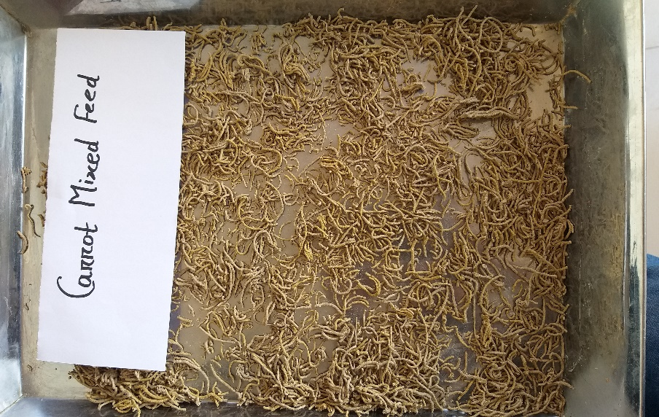
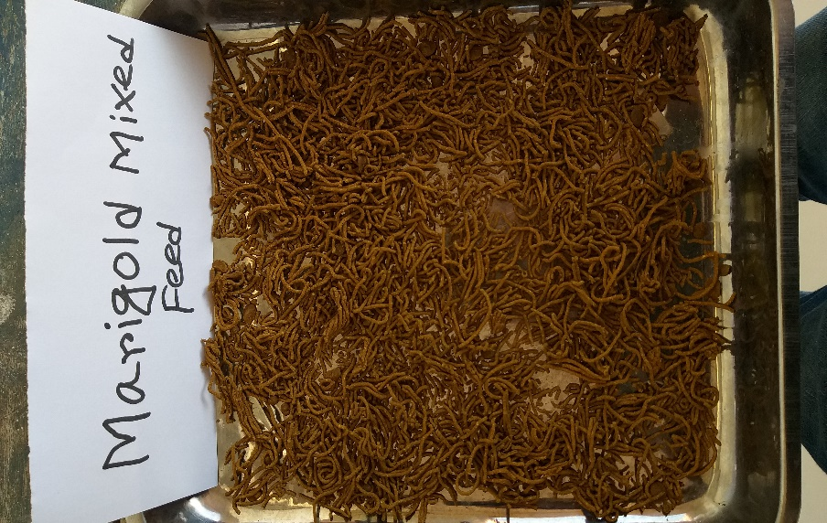
Carotenoid Value of Experimental Feed
Sl. No. | Ingredients Name | Carotenoid Value (mg/100kg)
01 | China Rose Flower Mixed Feed | 1.30
02 | Carrot Mixed Feed | 2.80
03 | Marigold Flower Mixed Feed | 16.50

Slide 15
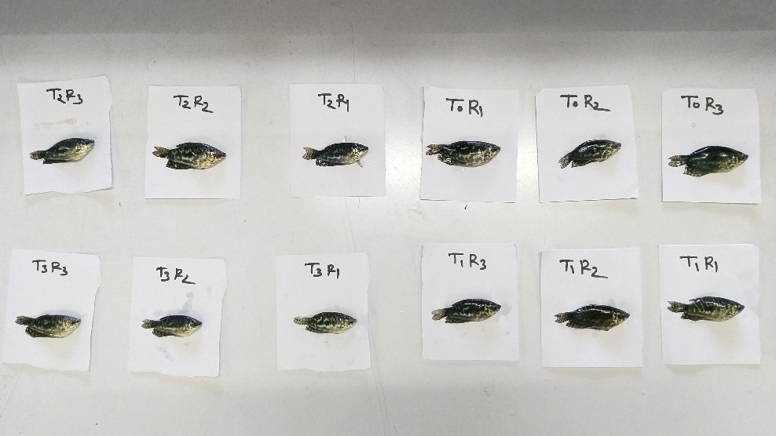
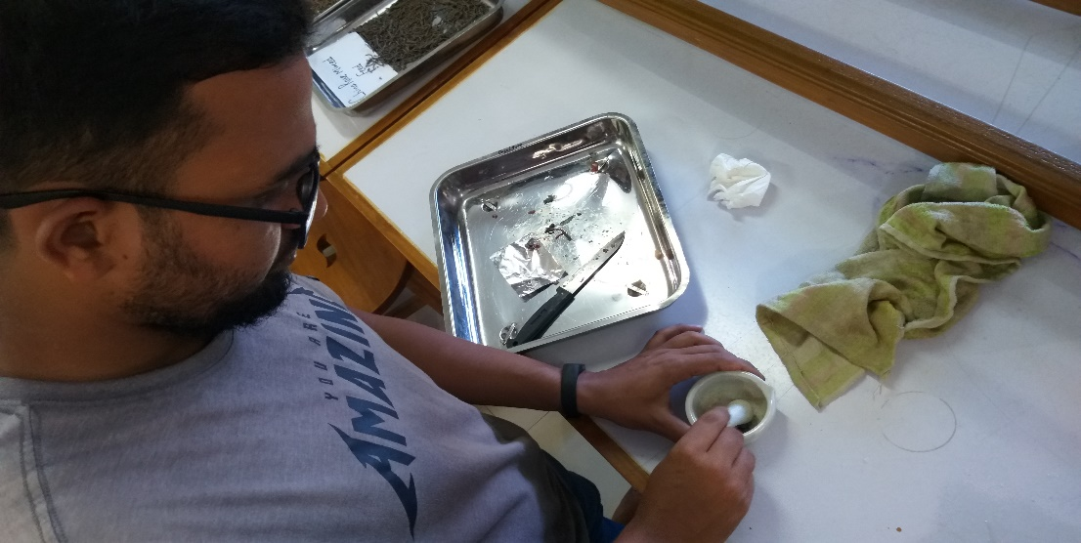
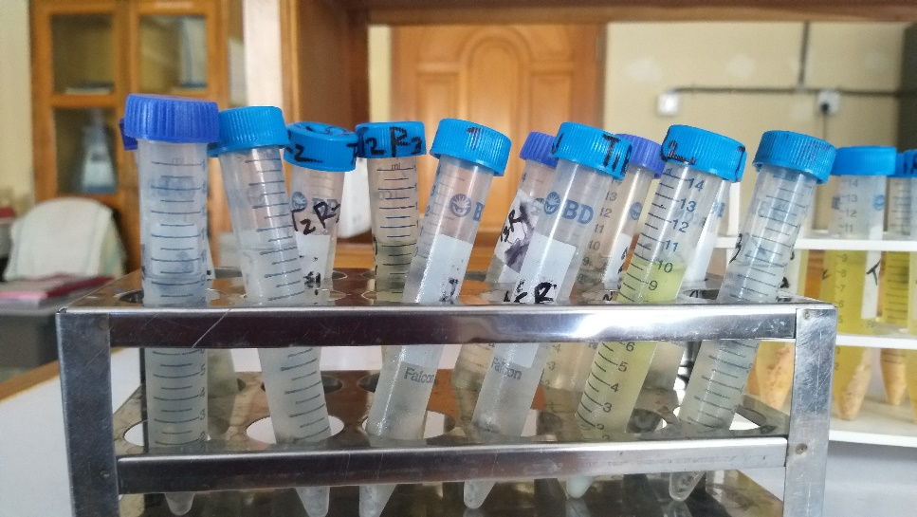
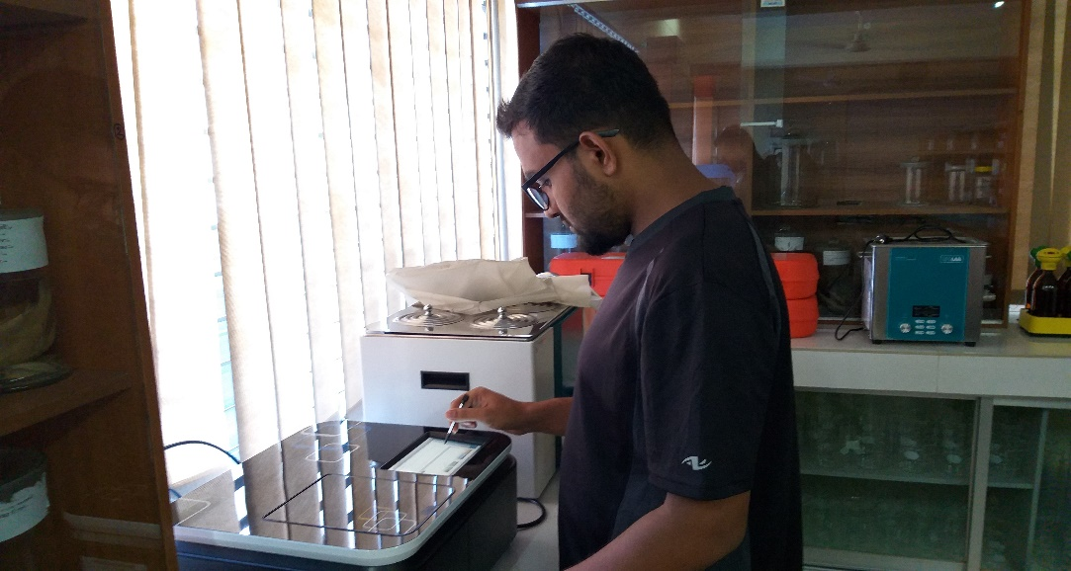
Sampling & Carotenoid Analysis

Slide 16
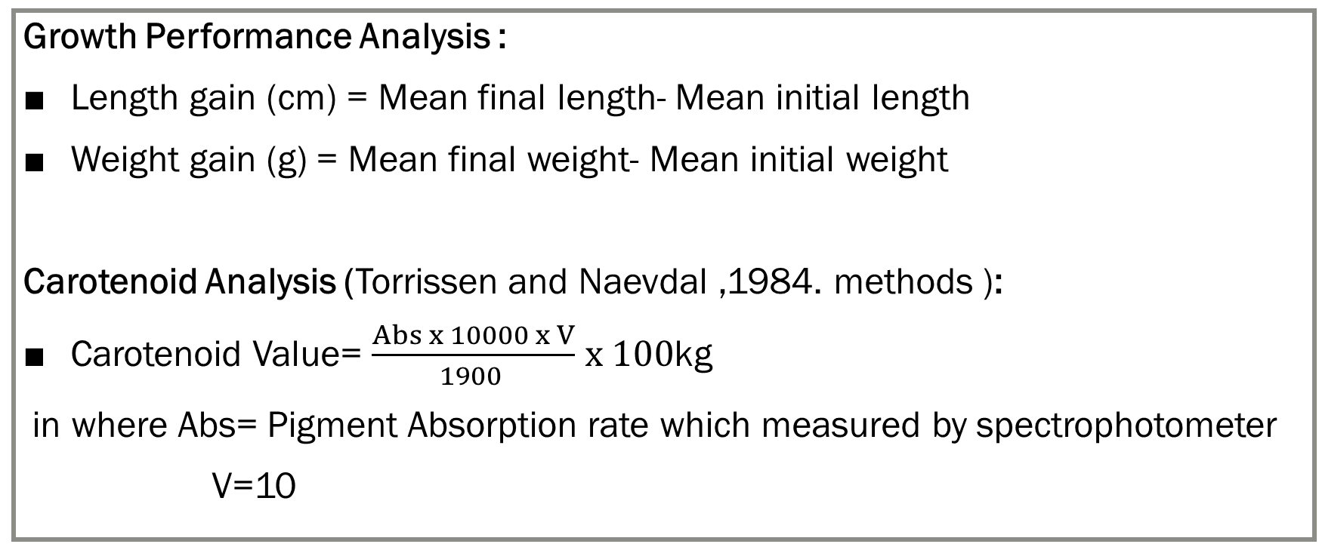
Analysis
Growth Performance Analysis :
Length gain (cm) = Mean final length- Mean initial length
Weight gain (g) = Mean final weight- Mean initial weight
Carotenoid Analysis (Torrissen and Naevdal ,1984. methods ):
Carotenoid Value= $\frac{Abs x 10000 x V}{1900 }$ $x 100$kg
in where Abs= Pigment Absorption rate which measured by spectrophotometer
V=10

Slide 17


Statistical Analysis

Slide 18
RESULTS

Slide 19
Weekly Carotenoid Content in Fish Tissue

Slide 20
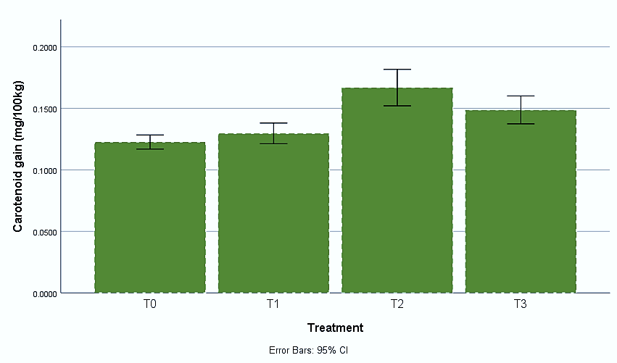
Final Carotenoid Gain in Fish Tissue

Slide 21
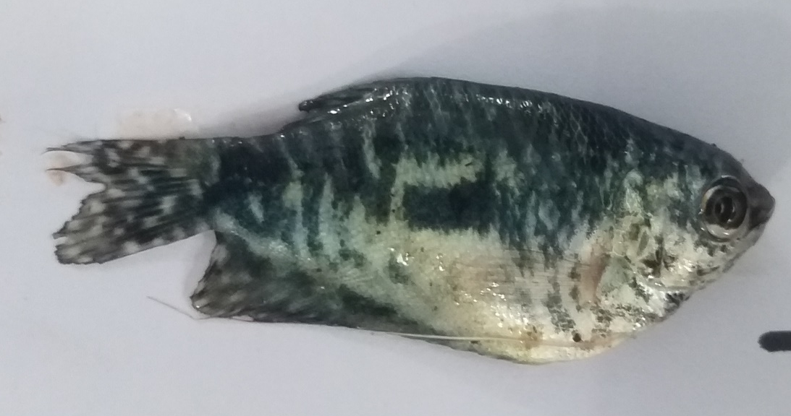
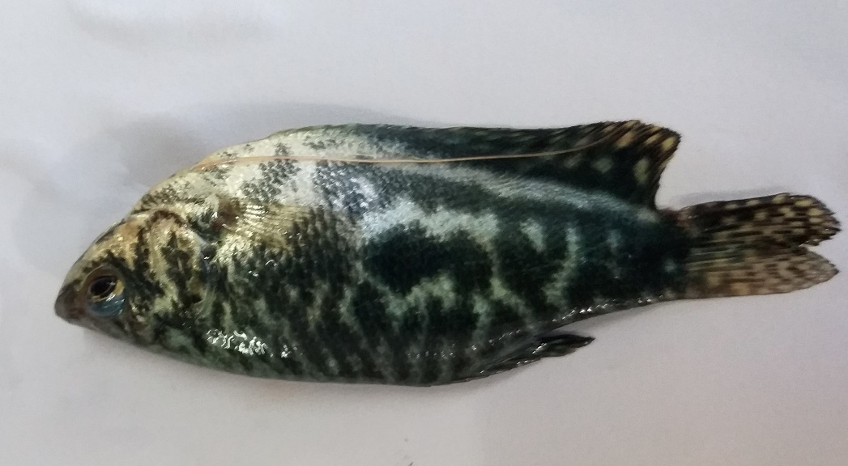
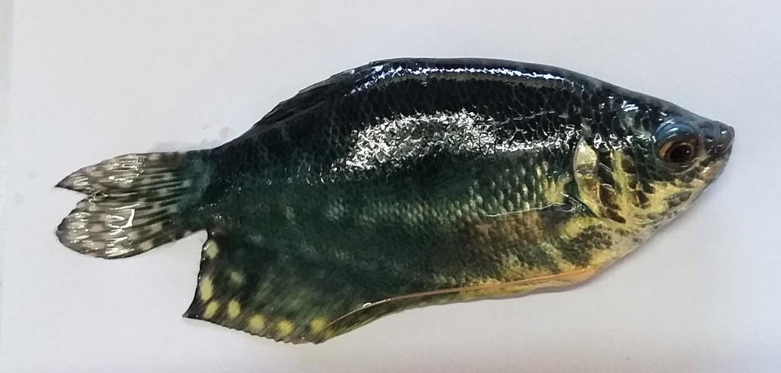
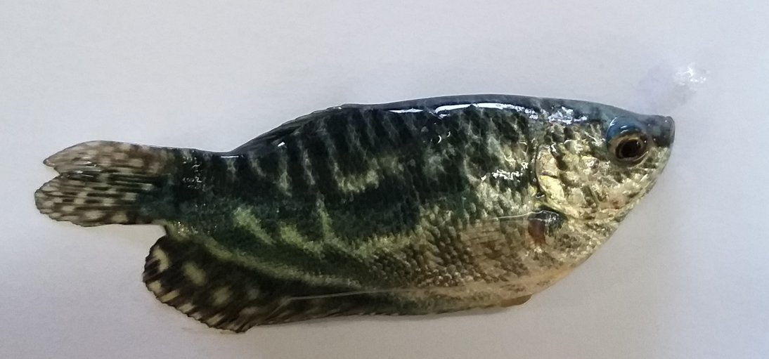
Final Carotenoid Gain of Blue Gourami
T0 (Control Feeds)
T1 (Chia Rose Mixed)
T2 (Marigold Mixed)
T3 (Carrot Mixed)

Slide 22
Growth Rate

Slide 23
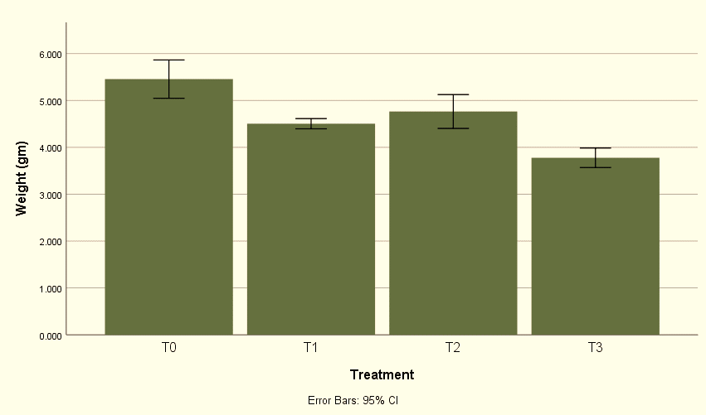
Final Weight Gain

Slide 24
Weekly Length Data

Slide 25
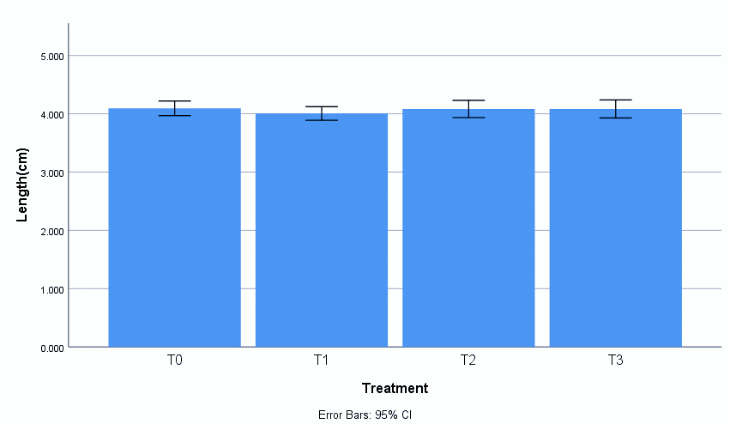
Final Length Gain

Slide 26
Survival Rate

Slide 27
Research Outcome
All Natural content mixed feed treatment (T1,T2,T3) shows better result in body coloration than the control feed(T0) treatment.
Among all experimental treatment T2 treatment (Marigold Flower mixed feed) fishes shows best result in carotenoid gain and in survival rate.

Slide 28
Conclusion
May ensure great potentiality for the use of natural plant-based carotenoids for pigmentation in aquaculture.
Has wide range of benefit to boosting fish coloration by using natural, environmentally friendly pigment
Will add a new dimension for progression of ornamental fish sector in Bangladesh.

Slide 29
Recommendation
Natural carotenoids mixed fed can replace artificial color enhancer.
Natural carotenoids may be used in improving the total coloration.
Farmer will be enabling to produce low-cost feed using natural carotenoid as it is locally available and very cheap.

Slide 30
Acknowledgement
Honorable Vice-chancellor, Chattogram Veterinary and Animal Sciences University.
Honorable Dean Prof. Dr. Nurul Absar Khan, Faculty of Fisheries
My supervisor (Shahida Arfine Shimul) and co-supervisor (Dr. Sk. Ahmad Al Nahid)
All other faculty members.
My family members, friends and all of my well-wishers.

Slide 31


